Slide 1
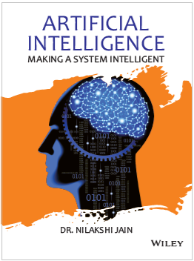
Chapter Fifteen
Application

Slide 2
Learning objectives.
15.1 Introduction
15.2 Category of application of AI
15.3 Natural language processing
15.3.1 Speech synthesis
15.3.2 Speech recognition
15.3.3 Natural language generation
15.4 Perception
15.4.1 Visual perception
15.4.2 Perception and reality
15.5 Robotics
15.5.1 What is robot?
15.5.2 Parts of robot
15.5.3 Robotic arm
15.6 Artificial neural network
15.7 AI trends in various sector
15.8 Communication using TELL and ASK
After this chapter , students will be able to :
Understand the various roles of artificial intelligence
Learn the advantages of an artificial intelligence
Understand the concept of perception

Slide 3
Introduction
15.1 Introduction
15.2 Category of application of AI
15.3 Natural language processing
15.3.1 Speech synthesis
15.3.2 Speech recognition
15.3.3 Natural language generation
15.4 Perception
15.4.1 Visual perception
15.4.2 Perception and reality
15.5 Robotics
15.5.1 What is robot?
15.5.2 Parts of robot
15.5.3 Robotic arm
15.6 Artificial neural network
15.7 AI trends in various sector
15.8 Communication using TELL and ASK
Businesses that uses artificial intelligence (AI) and its related technology are to reveal new insights “will steal $1.2 trillion per annum from their less informed peers by 2020.” predicts the Forrester Research.
Recent advances in AI have been helped by the following three factors:
Access to big data generated from e-commerce, businesses, governments, science, wearables and social media.
Improvement in machine learning (ML) algorithms—because of the availability of large amounts of data.
Greater computing power and the rise of cloud-based services—which helps run the sophisticated machine-learning algorithms.

Slide 4
Category of application of AI
15.1 Introduction
15.2 Category of application of AI
15.3 Natural language processing
15.3.1 Speech synthesis
15.3.2 Speech recognition
15.3.3 Natural language generation
15.4 Perception
15.4.1 Visual perception
15.4.2 Perception and reality
15.5 Robotics
15.5.1 What is robot?
15.5.2 Parts of robot
15.5.3 Robotic arm
15.6 Artificial neural network
15.7 AI trends in various sector
15.8 Communication using TELL and ASK
AI applications can be grouped into the following five categories:
Reasoning: The ability to solve problems through the logical deduction is known as reasoning. For example, financial asset management, legal assessment, financial application processing, autonomous weapons systems and games.
Knowledge: The ability to present knowledge about the world is termed as knowledge. For example, financial market trading, purchase prediction, fraud prevention, drug creation, medical diagnosis and media recommendation.
Planning: The planning is the ability to set and achieve goals. For example, inventory management, demand forecasting, predictive maintenance, physical and digital network optimization, navigation, scheduling and logistics.

Slide 5
Category of application of AI
15.1 Introduction
15.2 Category of application of AI
15.3 Natural language processing
15.3.1 Speech synthesis
15.3.2 Speech recognition
15.3.3 Natural language generation
15.4 Perception
15.4.1 Visual perception
15.4.2 Perception and reality
15.5 Robotics
15.5.1 What is robot?
15.5.2 Parts of robot
15.5.3 Robotic arm
15.6 Artificial neural network
15.7 AI trends in various sector
15.8 Communication using TELL and ASK
Communication: The ability to understand spoken and written language is known as communication. For example, real-time translation of spoken and written languages, real-time transcription, intelligent assistants and voice control.
Perception: Perception is the ability to infer things about the world by sounds, images and other sensory inputs. For example, medical diagnosis, autonomous vehicles and surveillance.

Slide 6
Natural language processing
15.1 Introduction
15.2 Category of application of AI
15.3 Natural language processing
15.3.1 Speech synthesis
15.3.2 Speech recognition
15.3.3 Natural language generation
15.4 Perception
15.4.1 Visual perception
15.4.2 Perception and reality
15.5 Robotics
15.5.1 What is robot?
15.5.2 Parts of robot
15.5.3 Robotic arm
15.6 Artificial neural network
15.7 AI trends in various sector
15.8 Communication using TELL and ASK
Natural language processing (NLP) is a subfield of AI and linguistic. It studies the problems inherent in the processing and manipulation of the natural language and natural language understanding devoted towards making computers understand statements written in the human languages.
Natural language understanding is sometimes referred to as an AI complete problem, because natural language recognition seems to require extensive knowledge about the outside world and the ability to manipulate it. The definition of understanding is one of the major problems in the natural language processing.
The major task in NLP are as follows;
Text-to-speech
Natural language generation

Slide 7
Natural language processing
15.1 Introduction
15.2 Category of application of AI
15.3 Natural language processing
15.3.1 Speech synthesis
15.3.2 Speech recognition
15.3.3 Natural language generation
15.4 Perception
15.4.1 Visual perception
15.4.2 Perception and reality
15.5 Robotics
15.5.1 What is robot?
15.5.2 Parts of robot
15.5.3 Robotic arm
15.6 Artificial neural network
15.7 AI trends in various sector
15.8 Communication using TELL and ASK
3. Question answering
4. Information extraction
5. Translation technology
6. Speech recognition
7. Machine translation
8. Information retrieval
9. Text roofing
10. Automatic summarization

Slide 8
Speech Synthesis
15.1 Introduction
15.2 Category of application of AI
15.3 Natural language processing
15.3.1 Speech synthesis
15.3.2 Speech recognition
15.3.3 Natural language generation
15.4 Perception
15.4.1 Visual perception
15.4.2 Perception and reality
15.5 Robotics
15.5.1 What is robot?
15.5.2 Parts of robot
15.5.3 Robotic arm
15.6 Artificial neural network
15.7 AI trends in various sector
15.8 Communication using TELL and ASK
Speech sensor is the artificial production of the human speech. A system used for the purpose is thunder speech synthesizer, and can be implemented in the software Ace Hardware speech synthesis orphan call text-to-speech systems in reference to the ability to convert text into speech.
Speech Recognition
Speech recognition technology allows computers equipped with a source of sound input such as that of a microphone-to-internet human speech. For example, for the transcription, SN alternative method of inter-acting with a computer.

Slide 9
Natural language generation
15.1 Introduction
15.2 Category of application of AI
15.3 Natural language processing
15.3.1 Speech synthesis
15.3.2 Speech recognition
15.3.3 Natural language generation
15.4 Perception
15.4.1 Visual perception
15.4.2 Perception and reality
15.5 Robotics
15.5.1 What is robot?
15.5.2 Parts of robot
15.5.3 Robotic arm
15.6 Artificial neural network
15.7 AI trends in various sector
15.8 Communication using TELL and ASK
Natural language generation is the natural language processing task of generating the natural language drum machine representation system such as the knowledge base or a logical form.
Stages
Content determination
Discourse planning
Sentence aggregation
Tickle assassing
Referring expression generation
Syntactic and morphological realisation
Orthographic realisation

Slide 10
Perception
15.1 Introduction
15.2 Category of application of AI
15.3 Natural language processing
15.3.1 Speech synthesis
15.3.2 Speech recognition
15.3.3 Natural language generation
15.4 Perception
15.4.1 Visual perception
15.4.2 Perception and reality
15.5 Robotics
15.5.1 What is robot?
15.5.2 Parts of robot
15.5.3 Robotic arm
15.6 Artificial neural network
15.7 AI trends in various sector
15.8 Communication using TELL and ASK
In Psychology and the Cognitive Sciences, perception is the process of acquiring, interpreting, selecting and organising sensory information. Essentially, methods of studying perception range are biological or psycho-logical approaches through the psychological approach to the certain abstract “thought experiments” of the mental philosophy.
Categories of perception
Internal
External

Slide 11
Visual perception
15.1 Introduction
15.2 Category of application of AI
15.3 Natural language processing
15.3.1 Speech synthesis
15.3.2 Speech recognition
15.3.3 Natural language generation
15.4 Perception
15.4.1 Visual perception
15.4.2 Perception and reality
15.5 Robotics
15.5.1 What is robot?
15.5.2 Parts of robot
15.5.3 Robotic arm
15.6 Artificial neural network
15.7 AI trends in various sector
15.8 Communication using TELL and ASK
Visual perception can be defined as one of the senses, consisting of the ability to detect light and interpret (see). It is the perception known as sight or the naked eye vision. Vision has a specific sensory system and a visual system.
Perception and reality
Many cognitive psychologist hold that, as humans move in the world, they create a model of how the world works. This implies that we sense the objective world, but our sensation map to percepts, and these percepts are provisional, the same sense that scientific hypotheses are provisional (cf. in the scientific method). As we acquire new information, our precepts shift.

Slide 12
What is a robot?
15.1 Introduction
15.2 Category of application of AI
15.3 Natural language processing
15.3.1 Speech synthesis
15.3.2 Speech recognition
15.3.3 Natural language generation
15.4 Perception
15.4.1 Visual perception
15.4.2 Perception and reality
15.5 Robotics
15.5.1 What is robot?
15.5.2 Parts of robot
15.5.3 Robotic arm
15.6 Artificial neural network
15.7 AI trends in various sector
15.8 Communication using TELL and ASK
Joseph Engelberger, a pioneer in the industrial robotics, once remarked “I can’t Define robot, but I know one when I see one”. Considering all the different machines that people called robot, it can be observed that it is nearly impossible to come up with a comprehensive definition.
Practically, robot is autonomous or semi-autonomous device, which performs its task either by direct human control. Partial control with human supervision is completely autonomously.
For example:
R2D2 and C-3PO: The intelligent, speaking robots with loads of personality in the Star Wars movies.
Sony’s AIBO: A robotic dog who learns through human interaction.
Honda’s ASIMO: A robot that can walk on two legs like a person.

Slide 13
Parts of a robot
15.1 Introduction
15.2 Category of application of AI
15.3 Natural language processing
15.3.1 Speech synthesis
15.3.2 Speech recognition
15.3.3 Natural language generation
15.4 Perception
15.4.1 Visual perception
15.4.2 Perception and reality
15.5 Robotics
15.5.1 What is robot?
15.5.2 Parts of robot
15.5.3 Robotic arm
15.6 Artificial neural network
15.7 AI trends in various sector
15.8 Communication using TELL and ASK
1.Controller
2.Arm
3. Drive
4. End-effector
5. Sensor
Robotic arm
A typical robotic arm is made up of seven metal segments, joined by six joints. The computer controls the robot by rotating individual step motors connected to each joint (some larger arms use hydraulic or pneumatic).
Unlike ordinary motors, step motors move in the exact increments. This allows the computer to move the arm very precisely, repeating exactly the same movement over and over again. The robot uses motion sensors to make sure it moves just the right amount.

Slide 14
Artificial neural network
15.1 Introduction
15.2 Category of application of AI
15.3 Natural language processing
15.3.1 Speech synthesis
15.3.2 Speech recognition
15.3.3 Natural language generation
15.4 Perception
15.4.1 Visual perception
15.4.2 Perception and reality
15.5 Robotics
15.5.1 What is robot?
15.5.2 Parts of robot
15.5.3 Robotic arm
15.6 Artificial neural network
15.7 AI trends in various sector
15.8 Communication using TELL and ASK
The neuron, or nerve cell, is the fundamental functional unit of all nervous system tissue including the brain. Each tissue consists of cell body, or soma, that contains a cell nucleus. Branching out from the cell body are a number of fibres known as dendrites and a single long fibre called the axon.
Each neuron is connected to the thousands of other neurons and communicates with them by electrochemical signals. Signals coming into neuron are received via junctions known as synapses.
These in turn are located at the end of branches of the neuron cell known as dendrites.
An artificial neuron is simply an electronically modelled biological neuron.
here are many different ways of connecting artificial neurons together to create a neural network, but this is restricted to one of the most common, which is called a feedforward network.

Slide 15
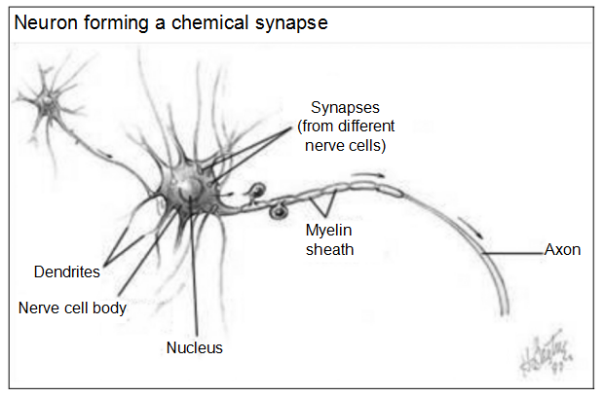
15.1 Introduction
15.2 Category of application of AI
15.3 Natural language processing
15.3.1 Speech synthesis
15.3.2 Speech recognition
15.3.3 Natural language generation
15.4 Perception
15.4.1 Visual perception
15.4.2 Perception and reality
15.5 Robotics
15.5.1 What is robot?
15.5.2 Parts of robot
15.5.3 Robotic arm
15.6 Artificial neural network
15.7 AI trends in various sector
15.8 Communication using TELL and ASK

Slide 16
AI trends in various sector
15.1 Introduction
15.2 Category of application of AI
15.3 Natural language processing
15.3.1 Speech synthesis
15.3.2 Speech recognition
15.3.3 Natural language generation
15.4 Perception
15.4.1 Visual perception
15.4.2 Perception and reality
15.5 Robotics
15.5.1 What is robot?
15.5.2 Parts of robot
15.5.3 Robotic arm
15.6 Artificial neural network
15.7 AI trends in various sector
15.8 Communication using TELL and ASK
Health care
Entertainment
Finance
Data security
Manufacturing
Automotive industry

Slide 17
Communication using TELL and ASK
15.1 Introduction
15.2 Category of application of AI
15.3 Natural language processing
15.3.1 Speech synthesis
15.3.2 Speech recognition
15.3.3 Natural language generation
15.4 Perception
15.4.1 Visual perception
15.4.2 Perception and reality
15.5 Robotics
15.5.1 What is robot?
15.5.2 Parts of robot
15.5.3 Robotic arm
15.6 Artificial neural network
15.7 AI trends in various sector
15.8 Communication using TELL and ASK
It is type of communication in which agents share the same internal representation language and also have an access to each other’s knowledge bases through TELL and ASK interface.
Agents A communicate with proposition P to B with TELL just as A would add P to its own knowledge based on TELL. Similarly, Agent A can find if Agent B is aware of Agent Q with ASK. This type of communication is known as telepathic communication

Slide 18
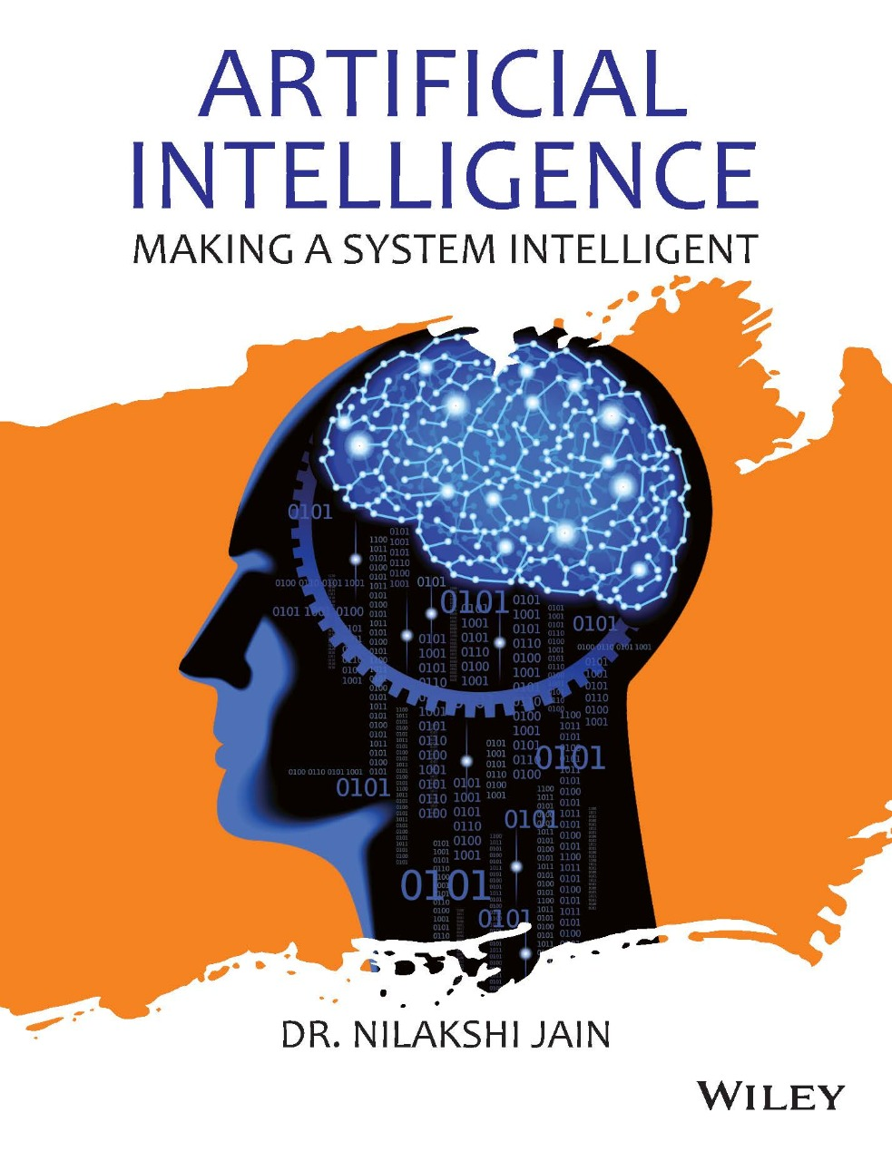
Dr. Nilakshi Jain Email ID : nilakshijain1986@gmail.com
Thank you

